Slide 1
Compromising Computers with Synthesized DNA, Privacy Leaks, and More
Peter Ney, Karl Koscher, Lee Organick, Luis Ceze, and Tadayoshi Kohno, University of Washington
USENIX 2017

Slide 2
Outline
Designing and creating DNA with malicious code
Security analysis of DNA processing programs
DNA sequencing side-channel
Notes:
三个部分：
创造包含恶意代码的DNA链理论上是否可行，攻击者想实现这种攻击会遇到啥难题？
人家调查了开源的DNA处理软件，这一部分介绍他们的发现
最后一部分是人家发现的一个有趣的侧信道

Slide 3
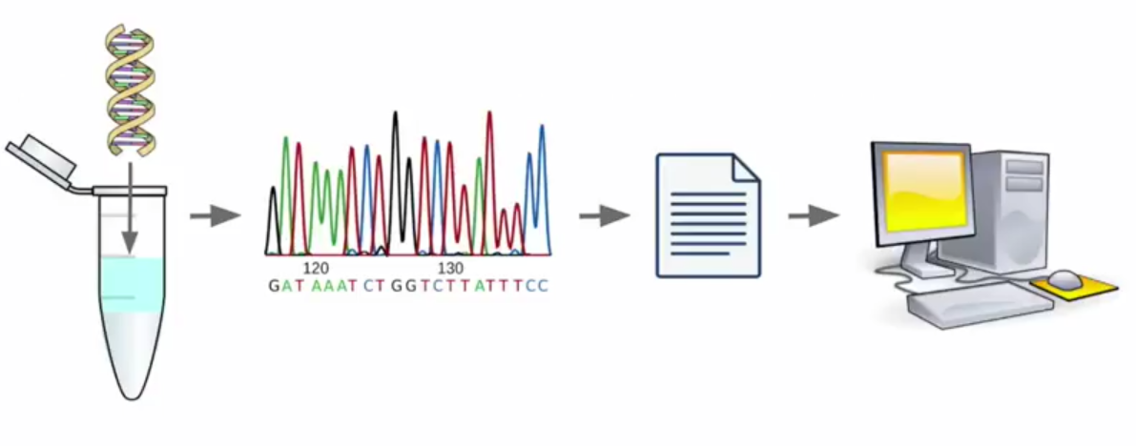
DNA Sequencing
Background
Notes:
DNA是遗传信息的主要携带者，所以测序就对搞生物的很有用，可以来理解生物学含义；所谓测序 就是确定ATCG四种碱基在DNA链上的排列顺序，测序得到的结果也是普通的文件，可以被计算机软件处理

Slide 4
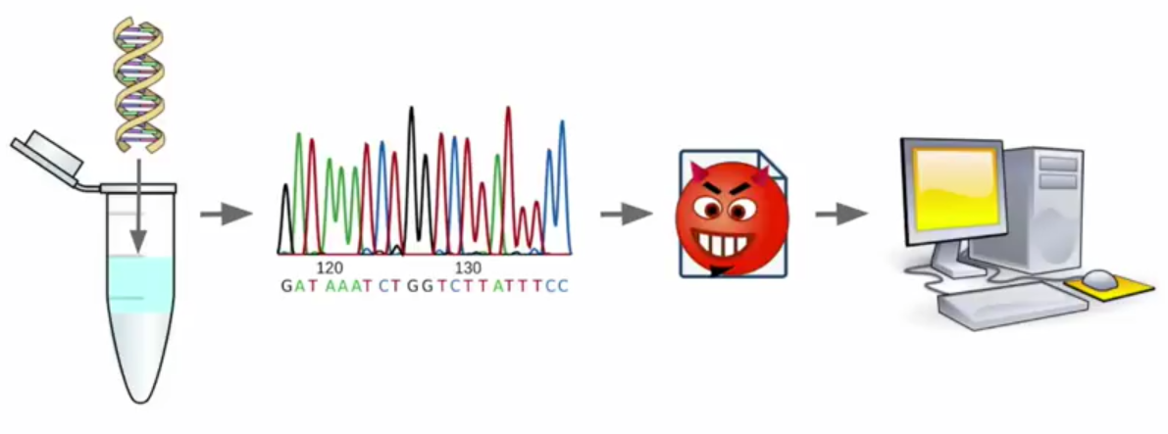
DNA Sequencing
Background
Notes:
我们知道只要攻击者能控制输入，就有可能攻击有漏洞的程序

Slide 5
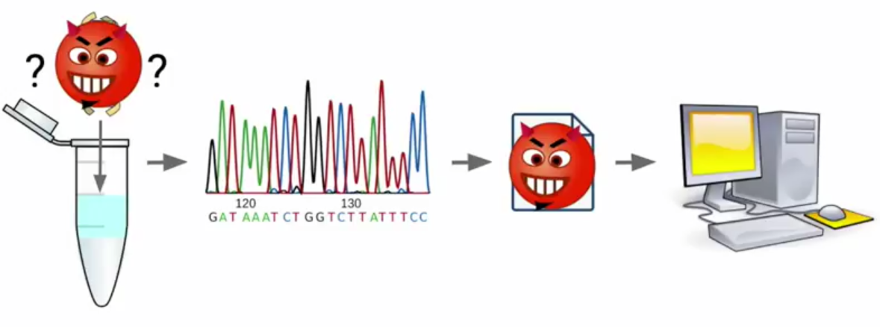
Can DNA Molecules Encode Malware?
Background
Notes:
能不能人为合成物理的DNA分子，当它们被测序的时候就产生恶意代码

Slide 6
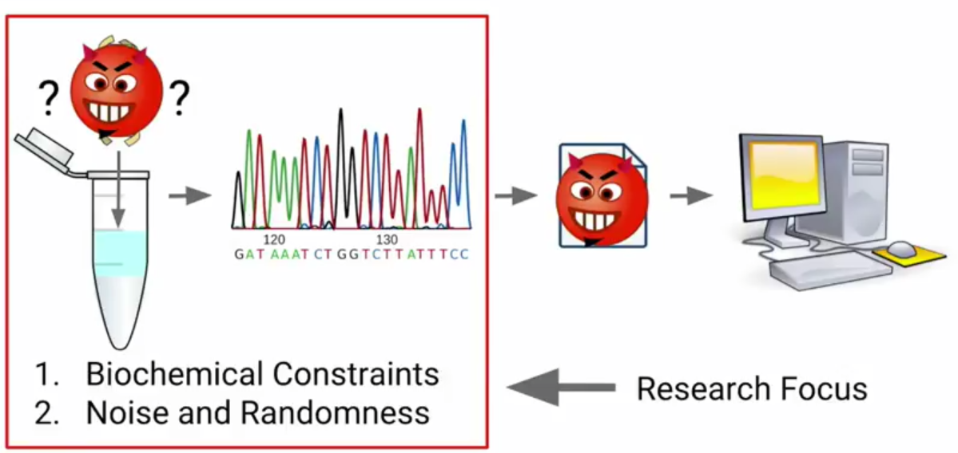
Can DNA Molecules Encode Malware?
Background
Notes:
问题来了，理论上可不可行呢？
有很多生物化学的限制，也就是说很多DNA是现有技术合成不了的
并且DNA测序过程中有很多噪音和随机性

Slide 7
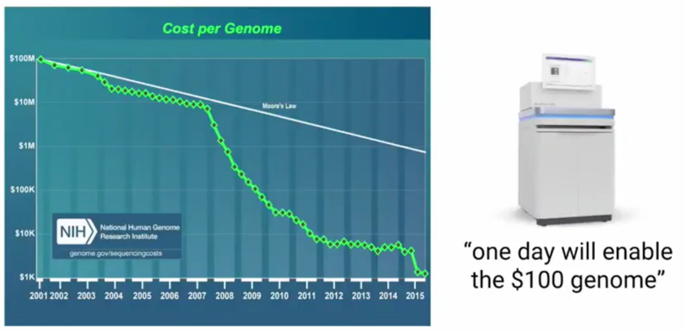
Exponential Improvements in DNA Sequencing
Background
Notes:
基因组测序的价格快速下降的 2001年一亿美元 而今天只要1000美元

Slide 8
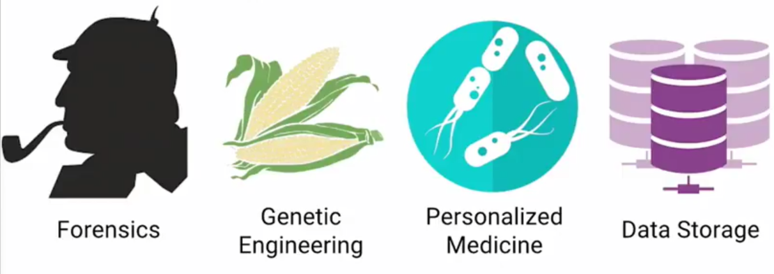
DNA Sequencing in New Domains
Background
Notes:
NGS测序技术的出现使得DNA分析被广泛使用： 确定嫌疑人的取证，基因编辑，个性化医疗，用物理的DNA来存储电子数据
这就给黑客窃取和操纵DNA

Slide 9
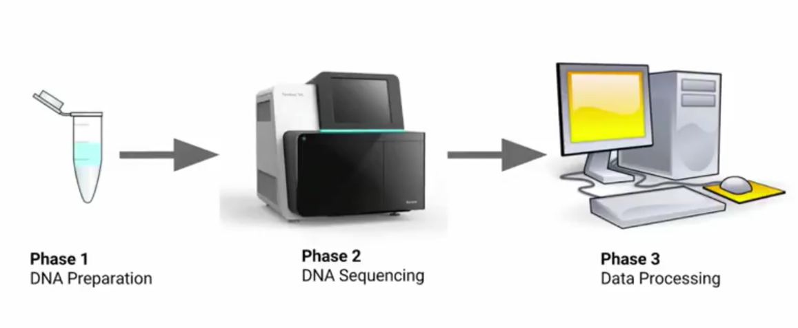
DNA Sequencing Workflow
Background
Notes:
最常用的测序工作流程
首先在湿实验室预处理样本为测序做准备，然后把样本送到测序仪，测序仪输出DNA测序文件，然后用生信处理软件处理测序文件来解答生物学问题

Slide 10
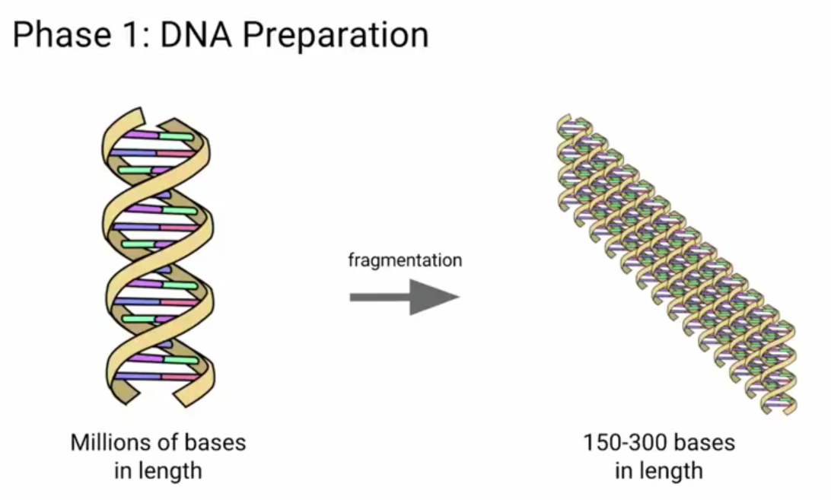
Background
Notes:
现在的测序仪只能测很短的片段

Slide 11
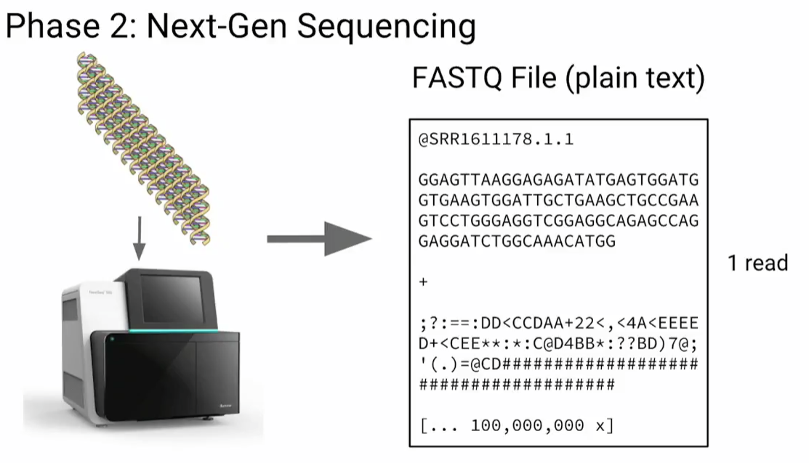
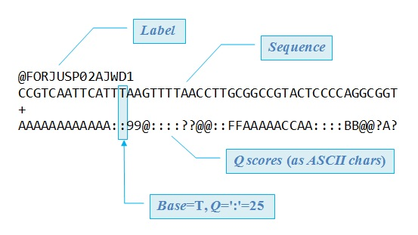
Background

Slide 12
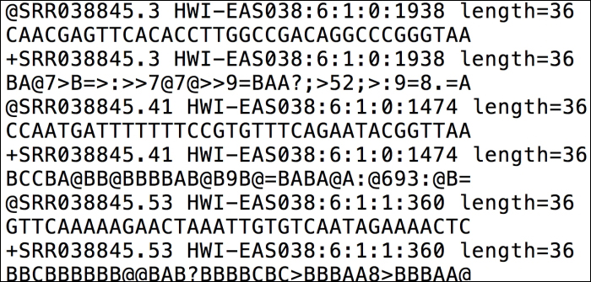
Background

Slide 13
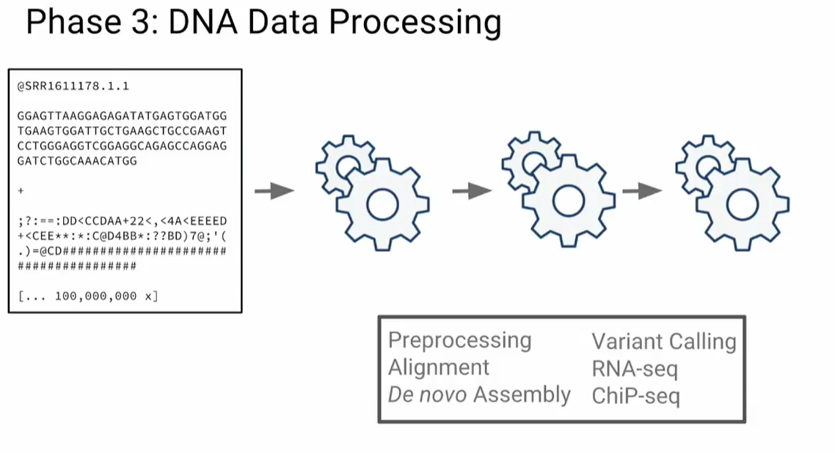
Background
Notes:
接下来就是一系列的处理 例如质量控制、与参考基因组比较发现变异位点、从头组装、比较样本之间的差异

Slide 14
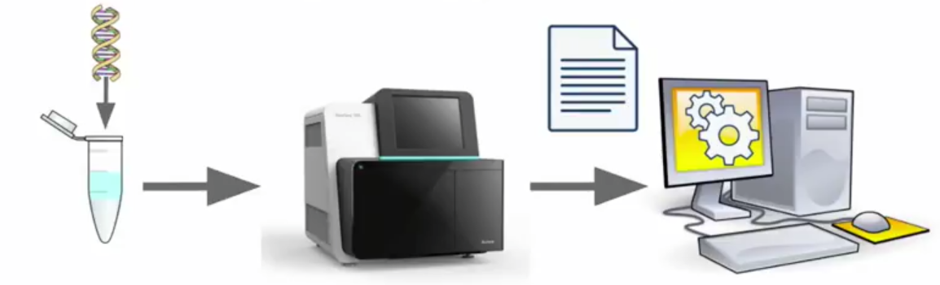
How Do We Make DNA with Malicious Code?
Make mal DNA
Find a vulnerability in DNA processing software
Construct a valid malicious sequencing file
Synthesize DNA that generates the file when sequenced

Slide 15
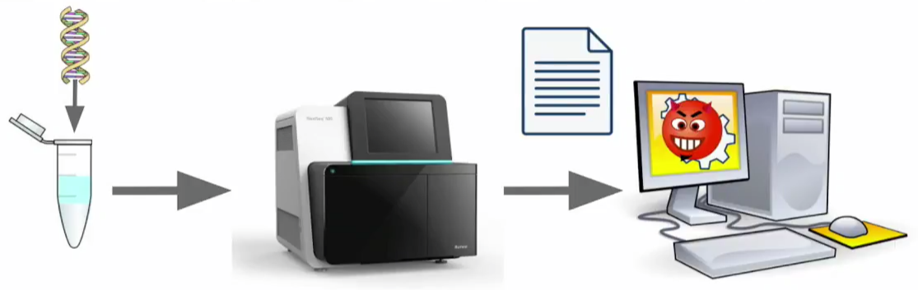
How Do We Make DNA with Malicious Code?
Make mal DNA
Find a vulnerability in DNA processing software
Construct a valid malicious sequencing file
Synthesize DNA that generates the file when sequenced

Slide 16
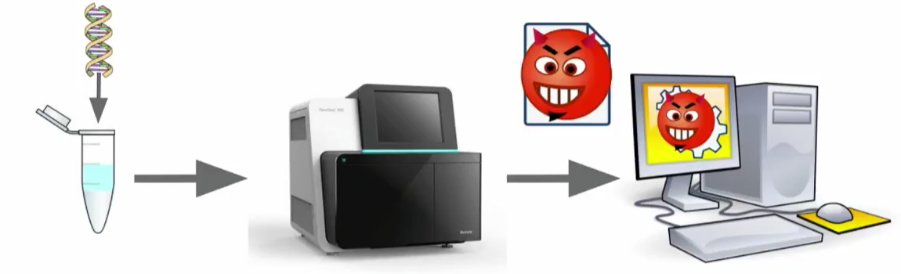
How Do We Make DNA with Malicious Code?
Make mal DNA
Find a vulnerability in DNA processing software
Construct a valid malicious sequencing file
Synthesize DNA that generates the file when sequenced

Slide 17
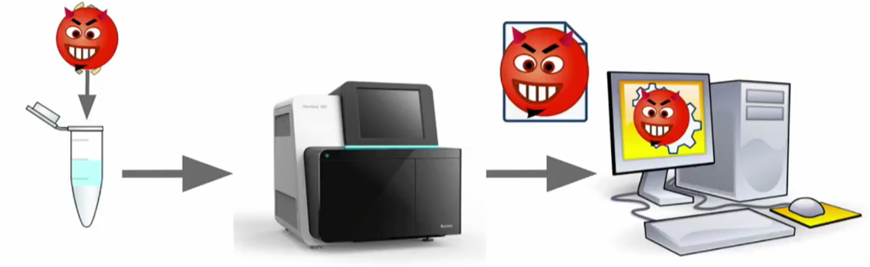
How Do We Make DNA with Malicious Code?
Make mal DNA
Find a vulnerability in DNA processing software
Construct a valid malicious sequencing file
Synthesize DNA that generates the file when sequenced

Slide 18
How Do We Make DNA with Malicious Code?
Make mal DNA
Find a vulnerability in DNA processing software
Construct a valid malicious sequencing file
Synthesize DNA that generates the file when sequenced
Notes:
着重于proof of concept，所以假设已经有了漏洞

Slide 19
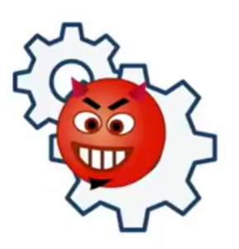
Proof-of-Concept: Simulated Software Vulnerability
Make mal DNA
Open-source FASTQ compression program fqzcomp
Added a buffer overflow vulnerability where DNA reads are processed
Disabled security features
No stack canaries and ASLR
Marked the stack as executable

Slide 20
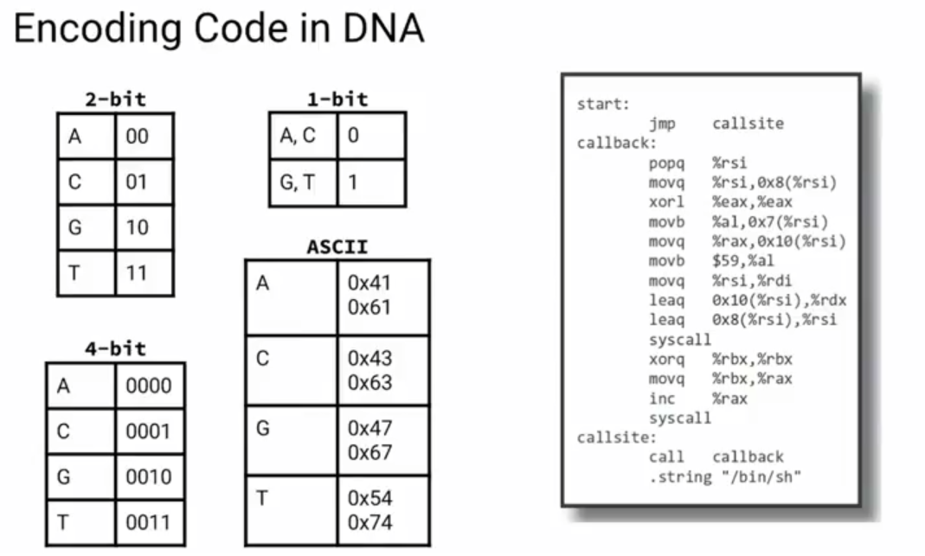
Make mal DNA

Slide 21
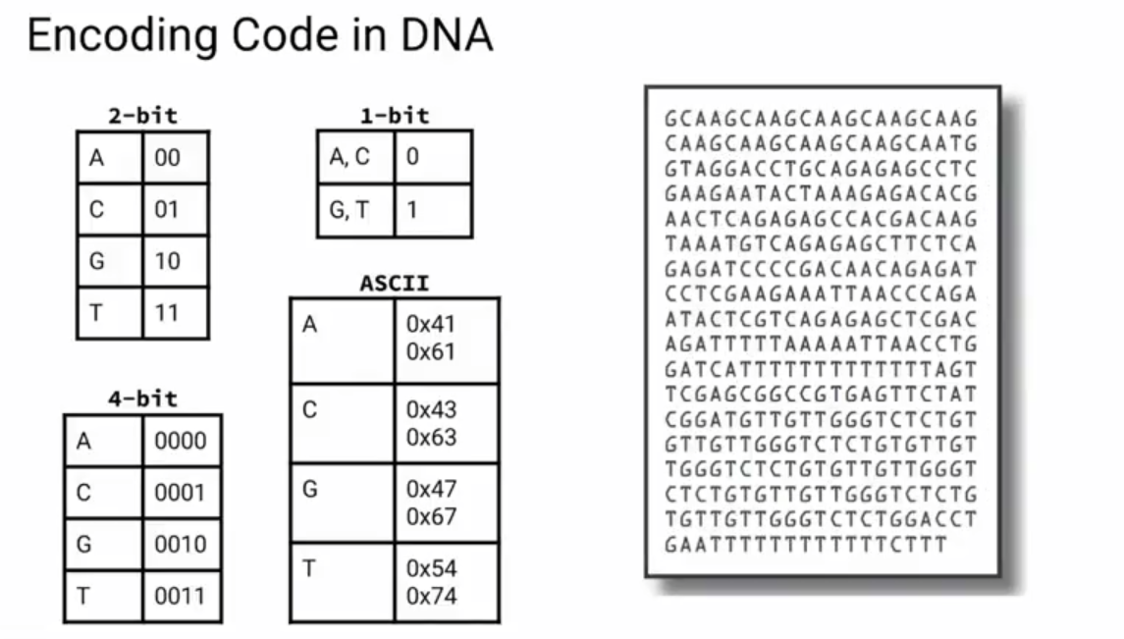
Make mal DNA

Slide 22
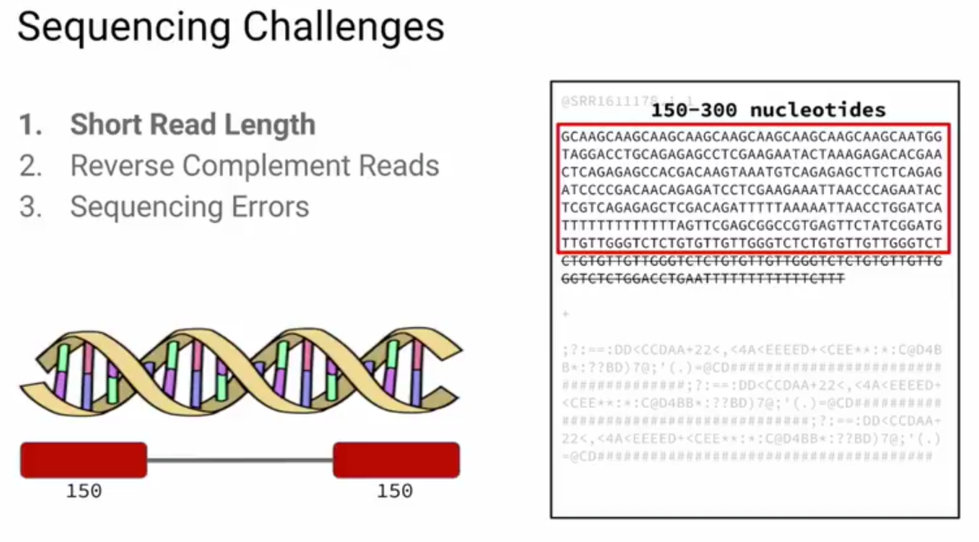
Make mal DNA

Slide 23
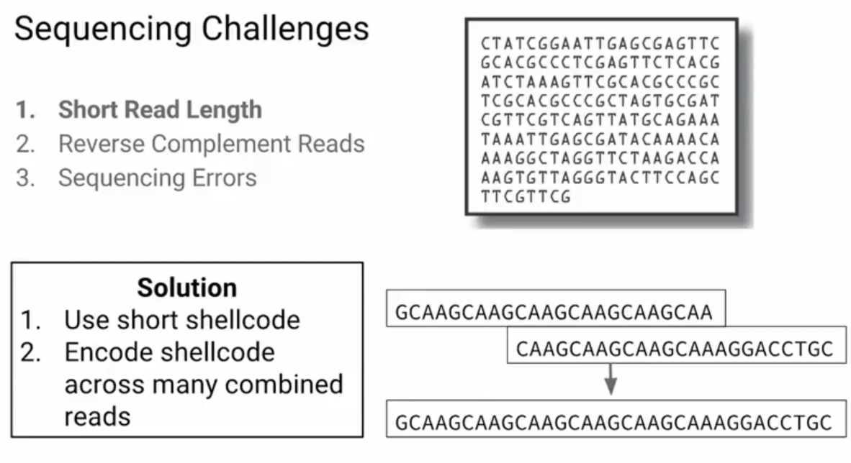
Make mal DNA

Slide 24
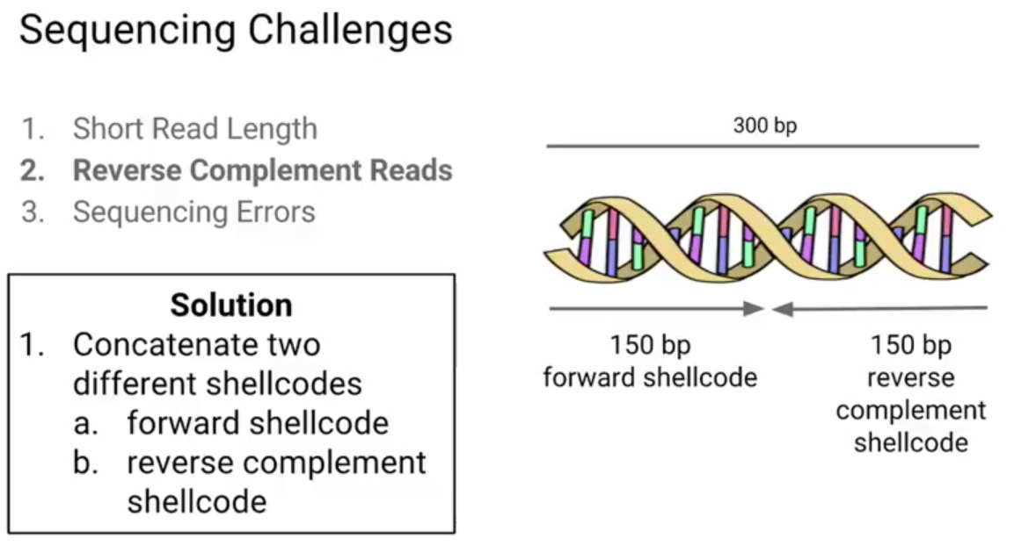
Make mal DNA

Slide 25
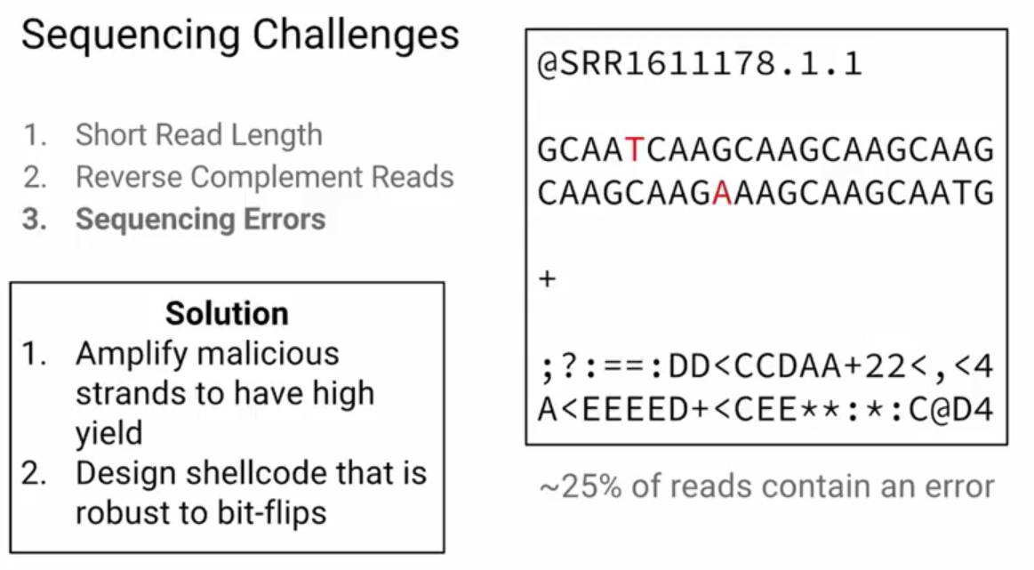
Make mal DNA

Slide 26
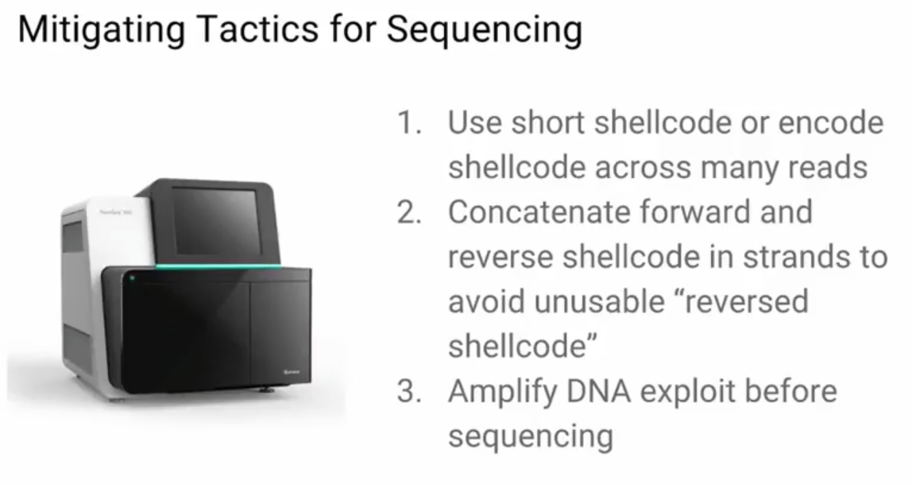
Make mal DNA

Slide 27
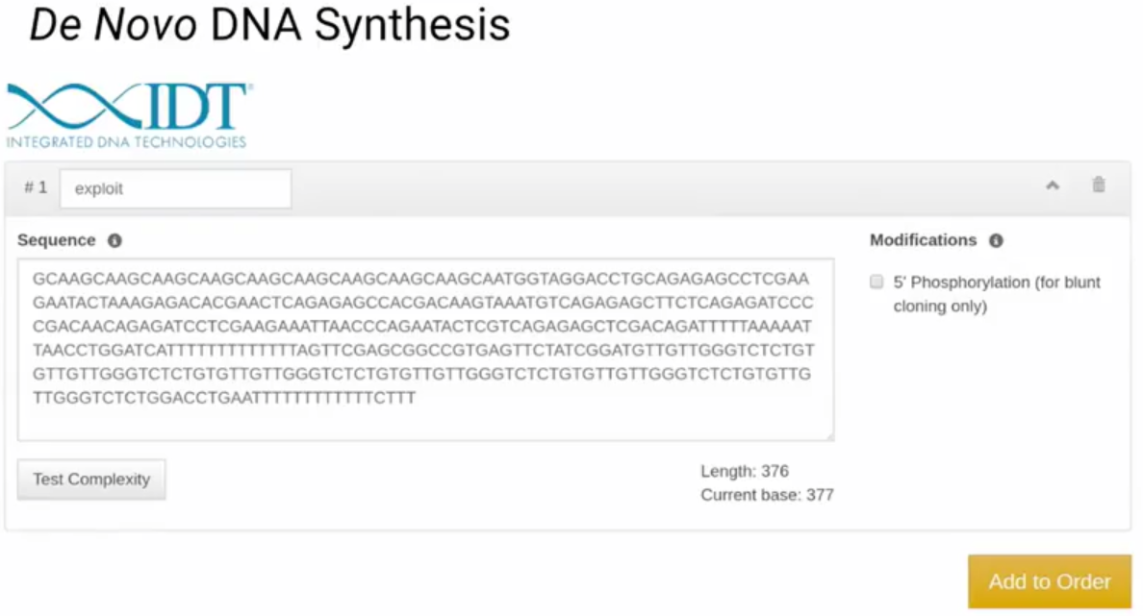
Make mal DNA

Slide 28
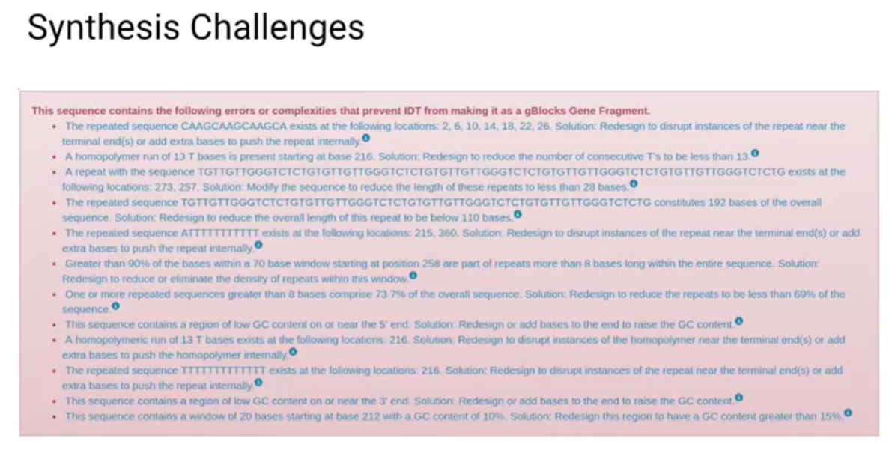
Make mal DNA

Slide 29
Make mal DNA
Repeated Sequences
GC-Content
Secondary Structures

Slide 30
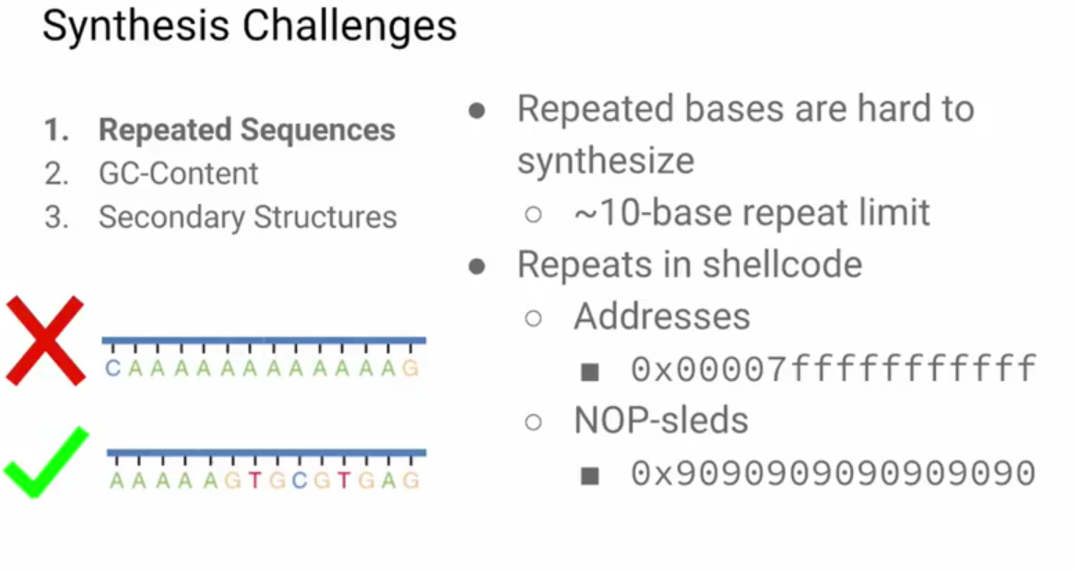
Make mal DNA

Slide 31
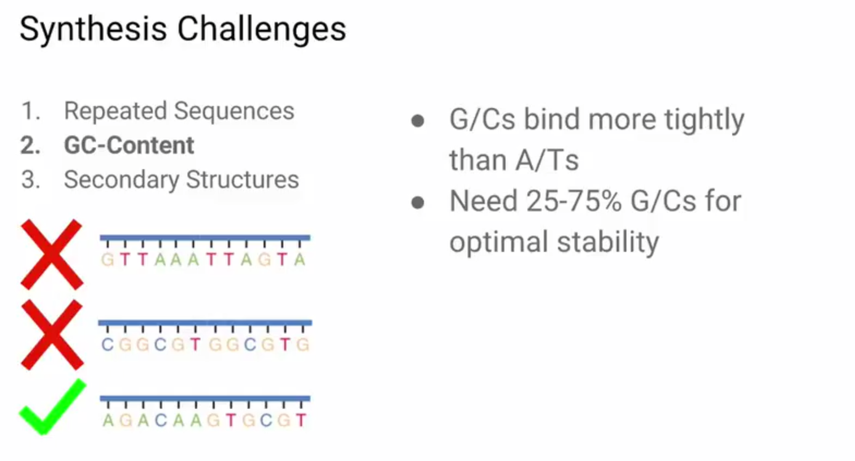
Make mal DNA

Slide 32
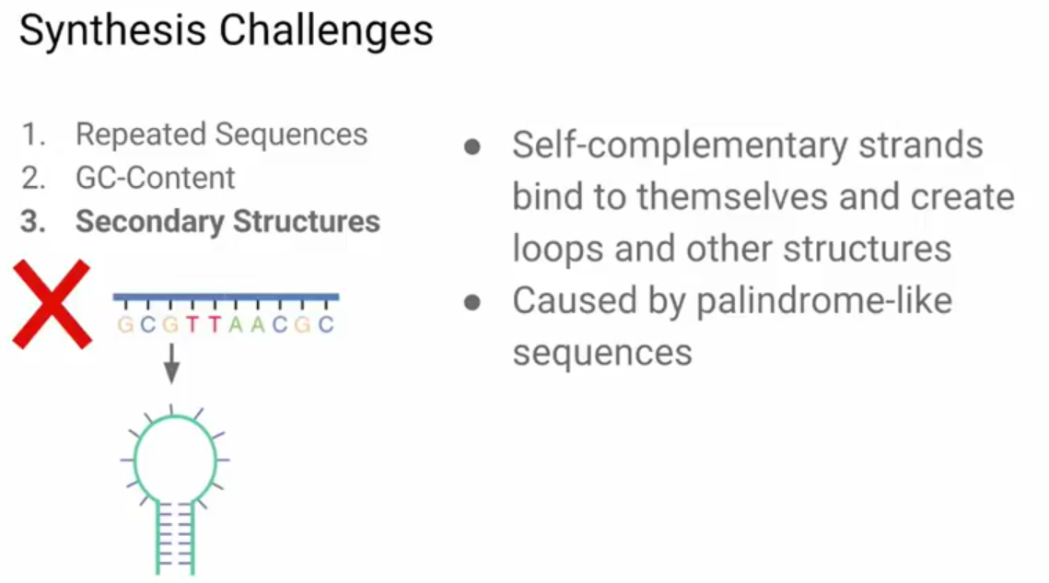
Make mal DNA

Slide 33
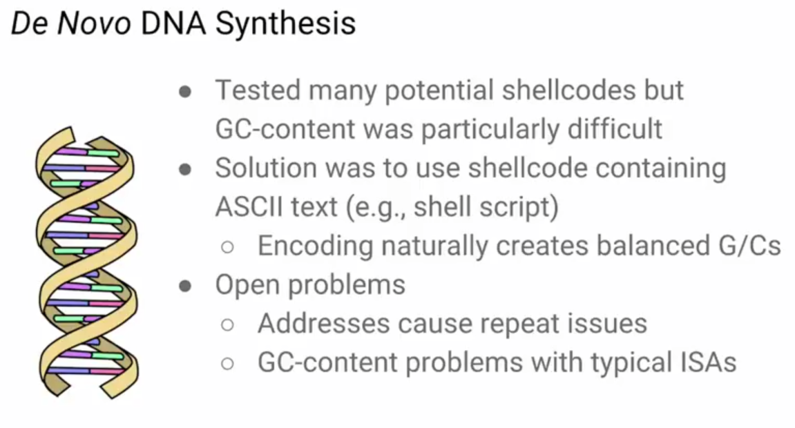
Make mal DNA

Slide 34
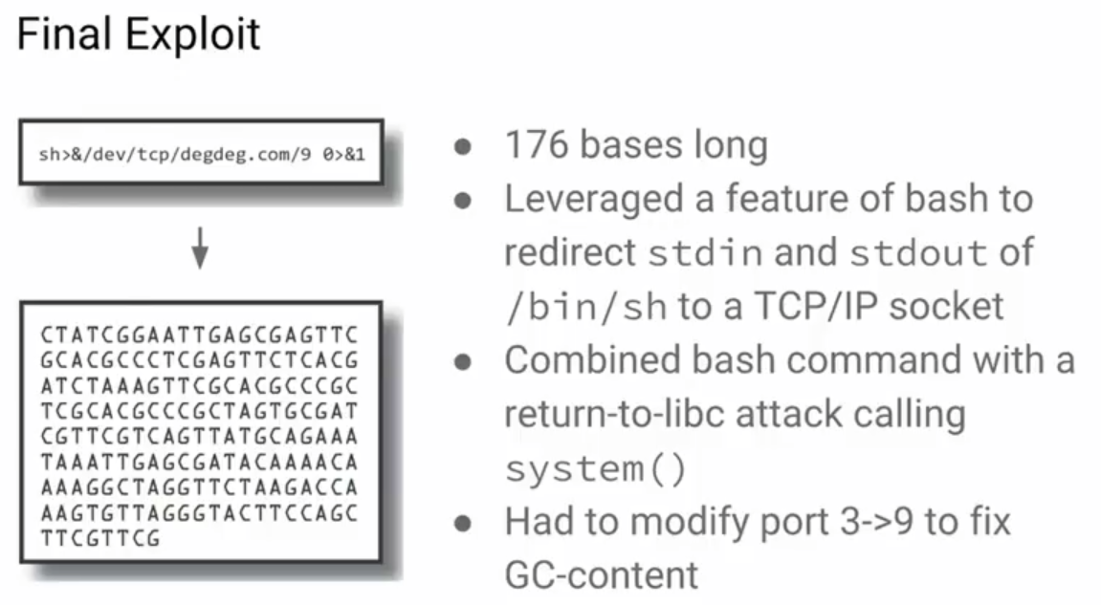
Make mal DNA

Slide 35
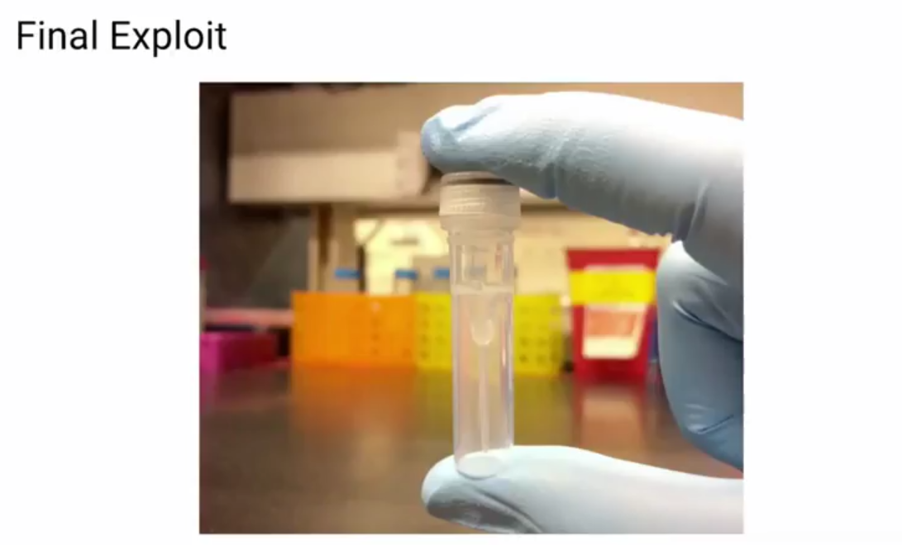
Make mal DNA

Slide 36
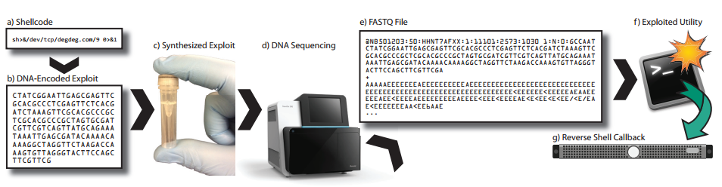
Make mal DNA
Exploit Summary

Slide 37
Outline
Designing and creating DNA with malicious code
Security analysis of DNA processing programs
DNA sequencing side-channel
Notes:
三个部分：
创造包含恶意代码的DNA链理论上是否可行，攻击者想实现这种攻击会遇到啥难题？
人家调查了开源的DNA处理软件，这一部分介绍他们的发现
最后一部分是人家发现的一个有趣的侧信道

Slide 38
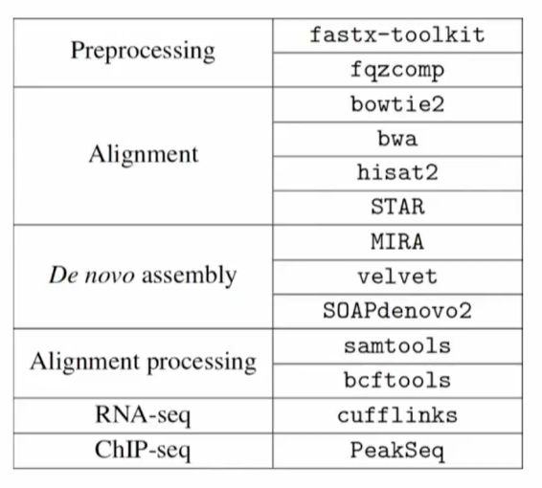
Security Analysis of DNA Analysis Programs
Software Analysis
13 open-source C/C++ DNA analysis utilities
Programs had to be available in bioinformatics workflow systems or used in a major bioinformatics effort
Included 7 different analysis categories

Slide 39
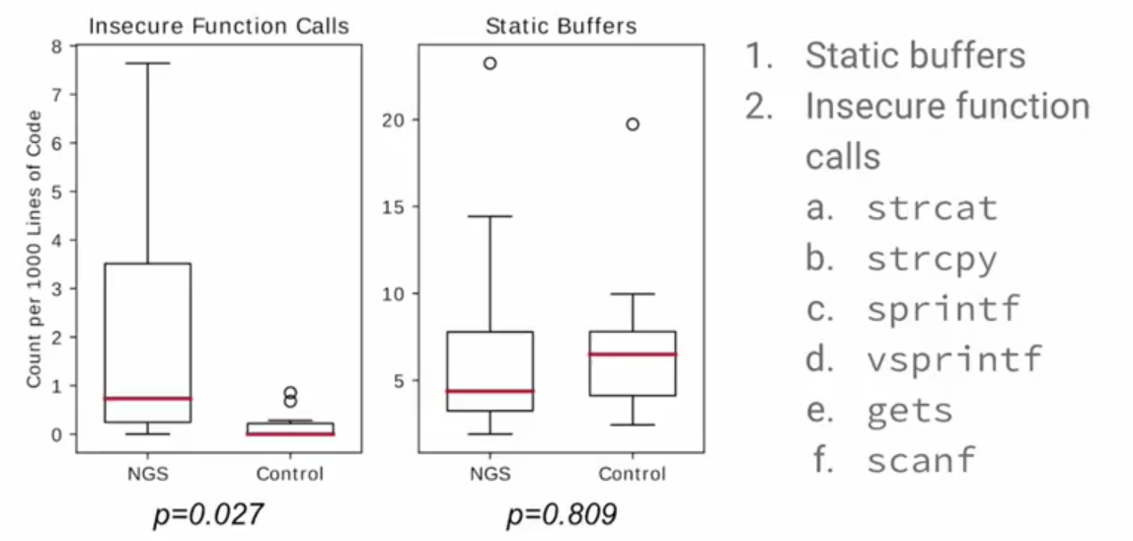
Signs of Poor Security Hygiene
Software Analysis
Notes:
对照组用的是一些网络程序 nginx php vsftpd

Slide 40
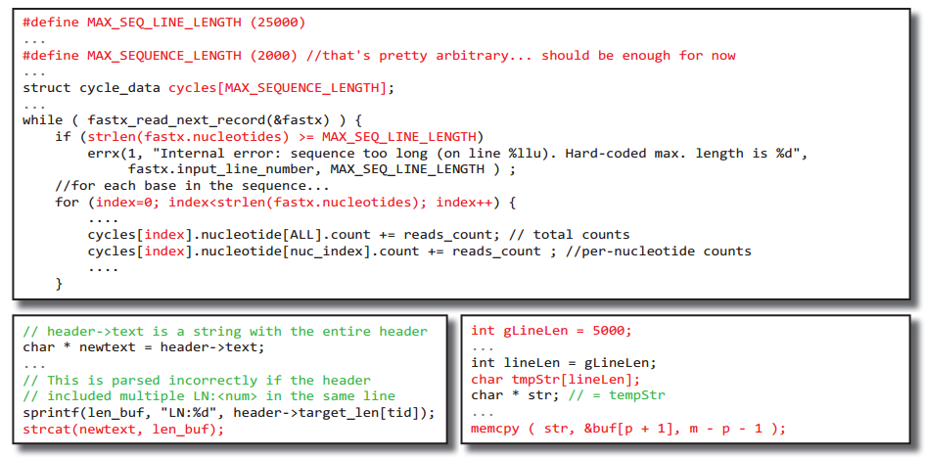
Vulnerabilities
Software Analysis

Slide 41
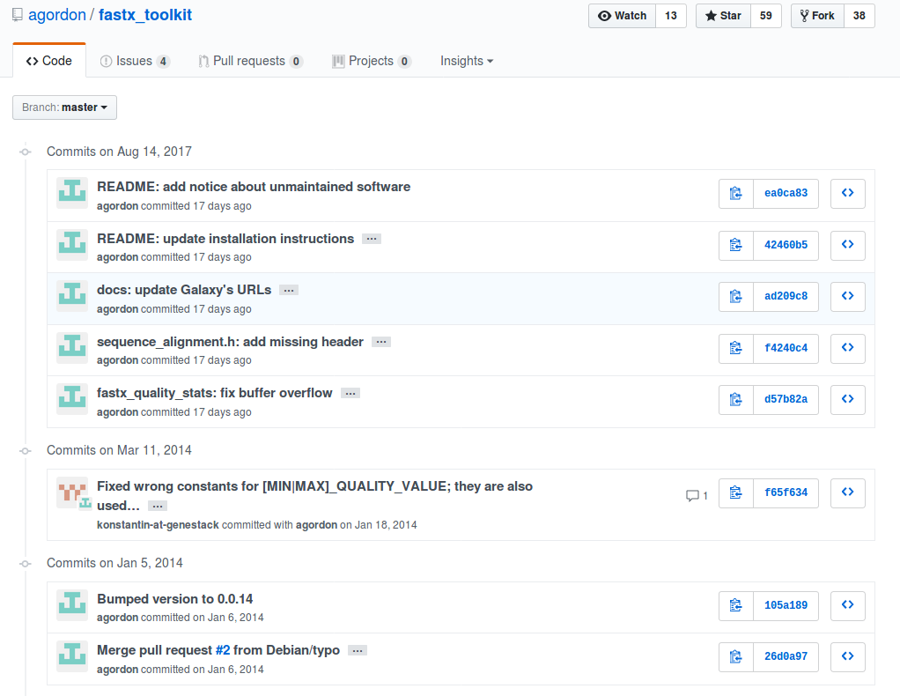

Slide 42
What should be avoided?
The lack of input sanitization
The use of insecure functions
The use of overflowable buffers

Slide 43
Outline
Designing and creating DNA with malicious code
Security analysis of DNA processing programs
DNA sequencing side-channel
Notes:
三个部分：
创造包含恶意代码的DNA链理论上是否可行，攻击者想实现这种攻击会遇到啥难题？
人家调查了开源的DNA处理软件，这一部分介绍他们的发现
最后一部分是人家发现的一个有趣的侧信道

Slide 44
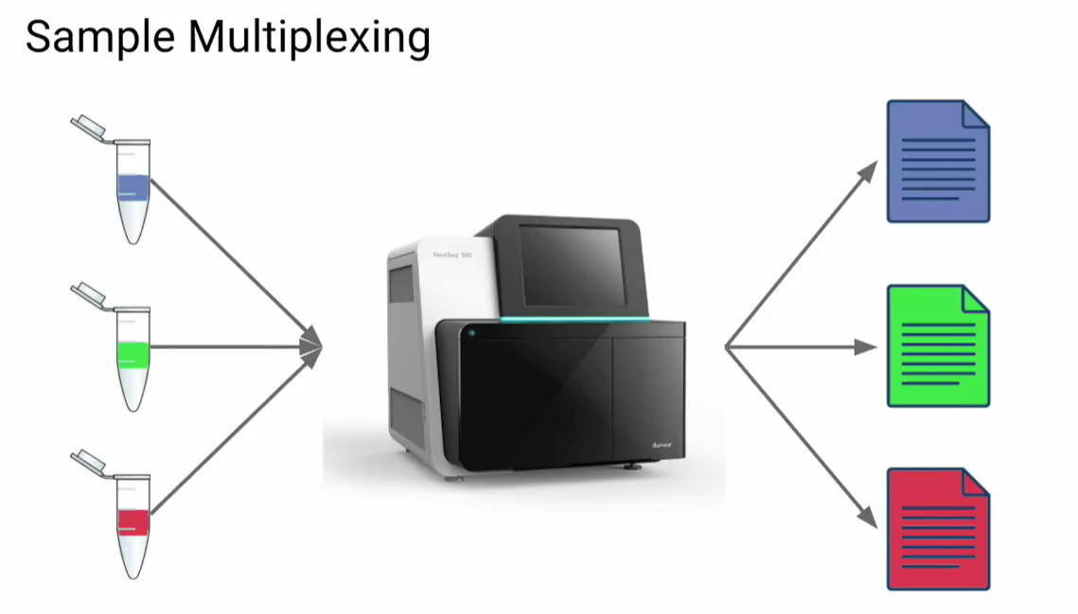
Side-channel

Slide 45
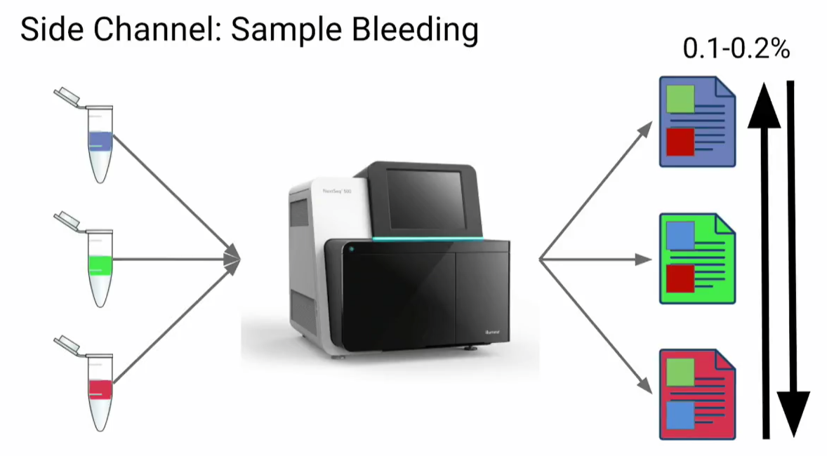
Side-channel

Slide 46
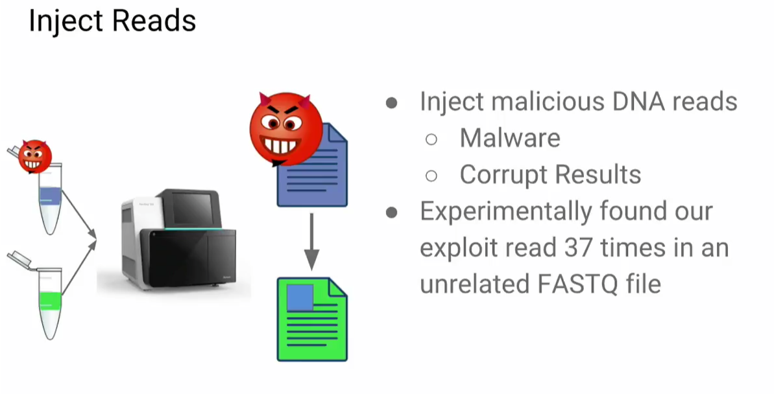
Side-channel

Slide 47
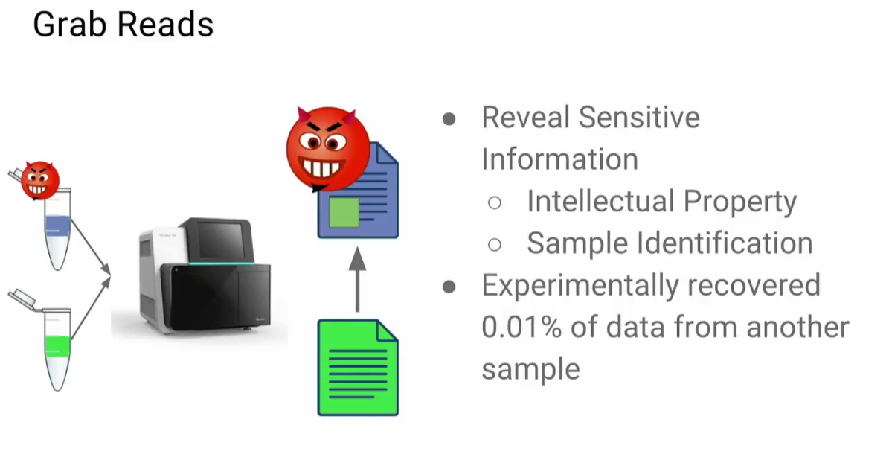
Side-channel

Slide 48
Defenses
Follow Best Practices for Secure Software
Secure Samples
Minimize Sample Bleeding
Detect Shellcode before Synthesis
Notes:
由于没有受到过攻击压力 所以并没有安全地开发 建议使用安全最佳实践 如输入过滤，使用内存安全的语言或者进行边界检查，进行定期安全审计；需要一个中心化的包管理仓库来管理和推送更新 如APT
在取证领域 攻击者就很有动力污染测序结果来导致错误的结果 这种情形下应该从测序的源头开始就紧密监控
最小化样本混合 如规定测序样本测序前必须经过验证 否则就分开测序；用技术方法来降低 比如改进分类算法，先把测序出来的数据交叉验证删掉错误分类的数据再交给用户
现有的政策阻止合成有害的生物DNA序列 比如流感病毒，虽然很难做，仍然鼓励研究人员找到对策来检测DNA里面的可执行代码

Slide 49
Summary
POC: DNA based exploits are theoretically possible but very hard to construct in practice
Security hygiene of bioinformatics software is poor
Changes in technology may make more attacks possible in the future
It is important to consider the security of DNA sequencing as it moves into new and important domains
DNA data storage, forensics, and personalized medicine

